Slide 1
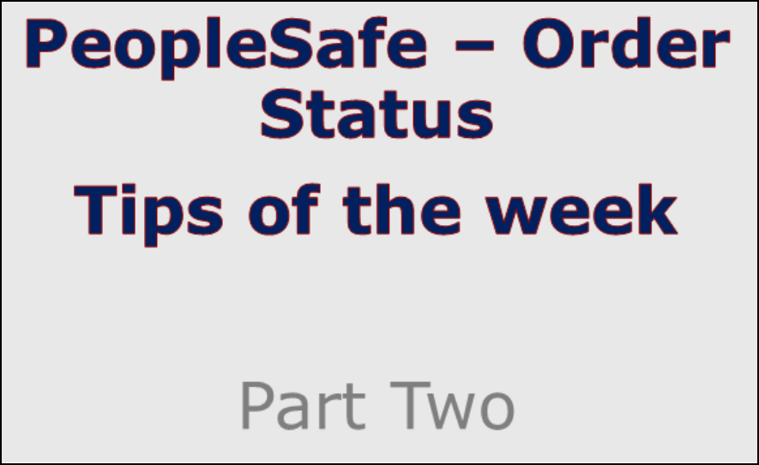
Note: Make sure you’re on the Mail tab instead of All tab.
Notes:
Note: Make sure you’re on the Mail tab instead of All tab.

Slide 2
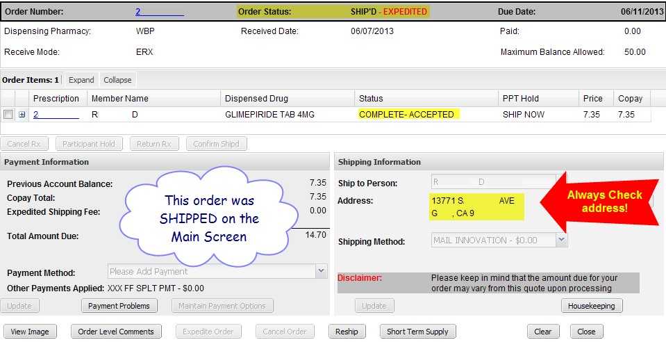

Always verify address on the Order Status screen to make sure it went to the right place.
If the order went to an incorrect address, it’s time to think RESHIP. Check the ORDER RESHIPS work instruction to ensure the order qualifies.
Reminder: Just because PeopleSafe says the order is shipped, doesn’t mean it is on the truck yet! Check to see what time the order completed (on Prescription Details screen). For more info, see the ORDER STATUS work instruction and search (CTRL‐F) for “Shipped”.

Slide 3
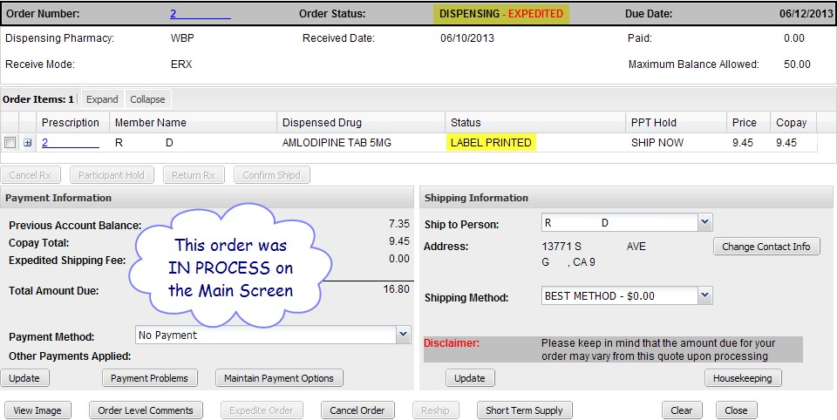
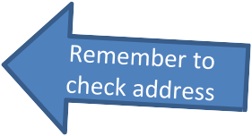

The order shown above is in the “Dispensing” status, and the prescription status is “Label Printed.” This means all conflicts have been resolved and the order has entered the fulfillment process. “Label Printed” means the Rx label is being printed and placed on the bottle, not the shipping label.
Check both the Order Status at the top of the screen and the Status of each Rx in the order to determine what state the order is currently in. For assistance interpreting your results,
see the ORDER STATUS work instruction in theSource.

Slide 4
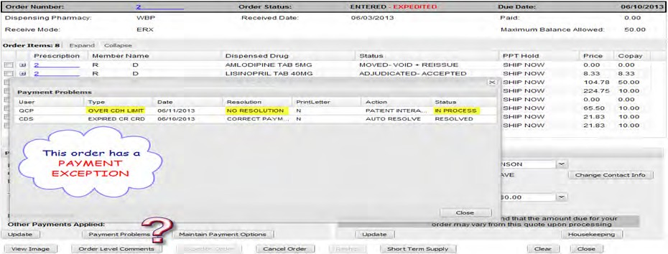

There is a payment issue. Look up the details by clicking on the “Payment Problems” button as well as the Order Level Comments button. Ask the member for the necessary information to resolve the issue. The order above has an “Over Cardholder Limit” problem. This means the member needs to make a payment before the order can be shipped.

Slide 5
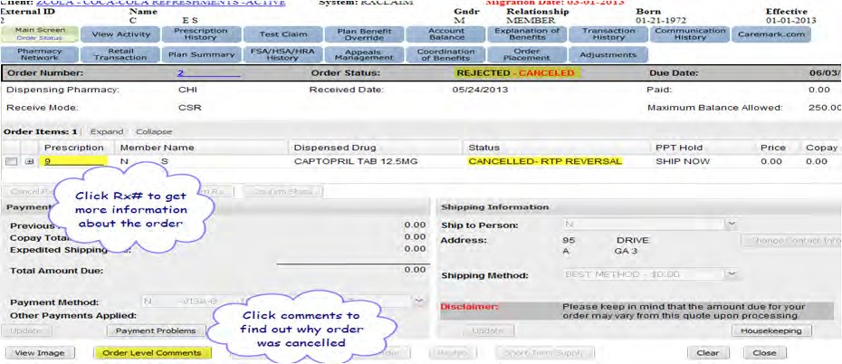

There could be a number of reasons an order might get cancelled. The important step to take is to research into the “story” of the order to find out why.

Slide 6
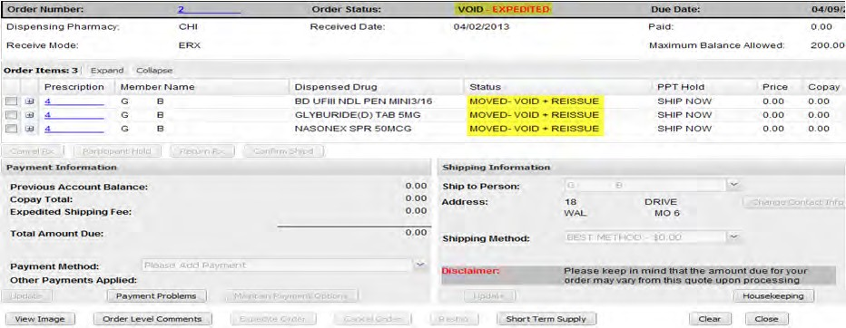

This means the prescriptions were moved to another order. Check the main screen for a newer order for the medications.

Slide 7
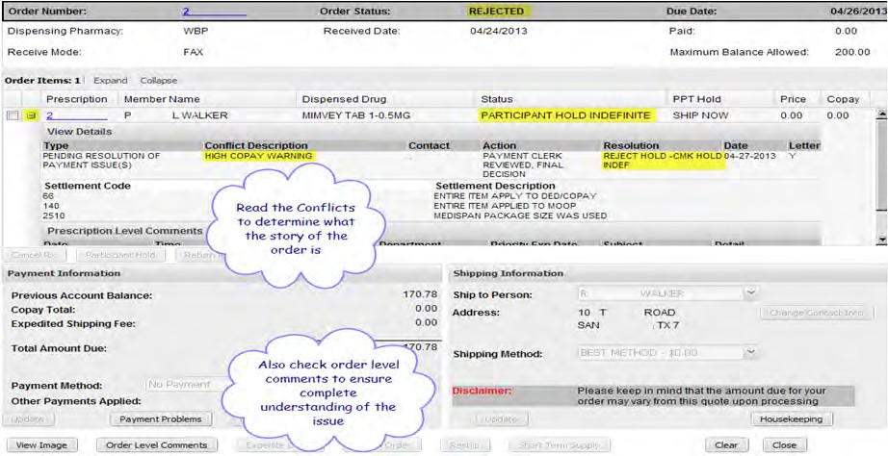


This order is showing a status of REJECTED and the prescription is PARTICIPANT HOLD INDEFINITE. Click the + by the Rx# to read the details of the prescription.
Also read all order level comments. The order above was placed on hold by finance due to a high co‐
pay warning that the member did not respond to.

Slide 8
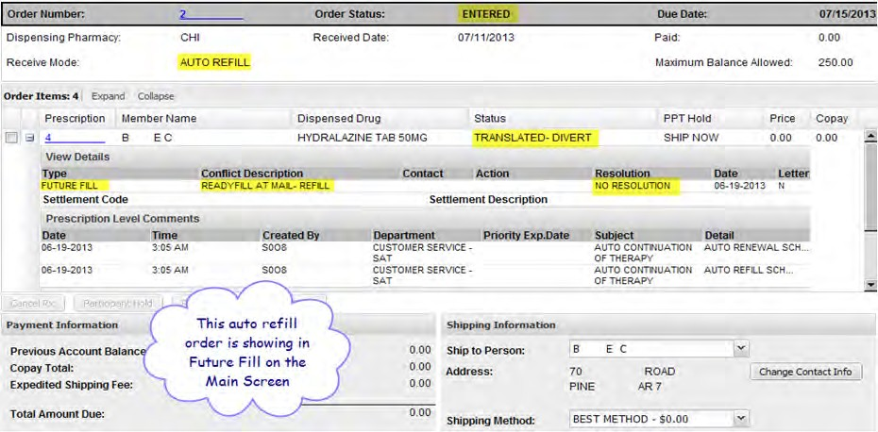


Research conflicts, problems and comments as always to get the full story. TRANSLATED‐DIVERTED
can indicate such items as eligibility, NIS (Not in Stock), or Rx Clarification needed from doctor.
It could also be a simple ReadyFill at Mail order going through its normal process, as shown above.

